Slide 1

Supply Chain Management Dashboard
Akshay M
August 9, 2024
Business Analysis internship

Slide 2
Detailed Project Report
Introduction: Brief overview of the project and objectives.
Data: Information about the dataset and ETL process.
Analysis: Detailed analysis with visualization.
Findings: Key insights and relationship discovered.
Conclusion: A Brief summary of the project.

Slide 3
Introduction
The objective of this project is to create a comprehensive Supply Chain Management
(SCM) Dashboard using Tableau. This dashboard will help monitor and optimize various
aspects of the supply chain, including inventory levels, order fulfillment, supplier
performance, transportation efficiency, and overall supply chain costs.

Slide 4
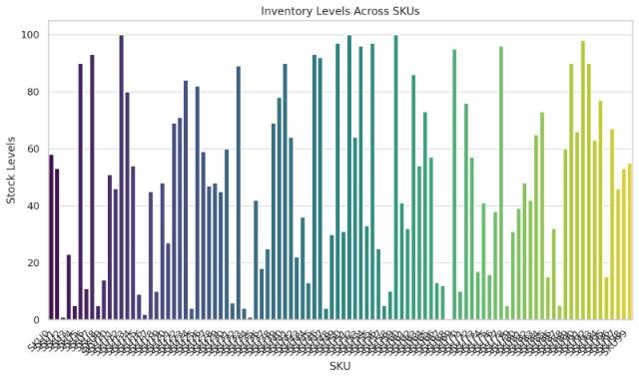
Inventory Levels Across SKU’s
Stock levels across different SKUs

Slide 5
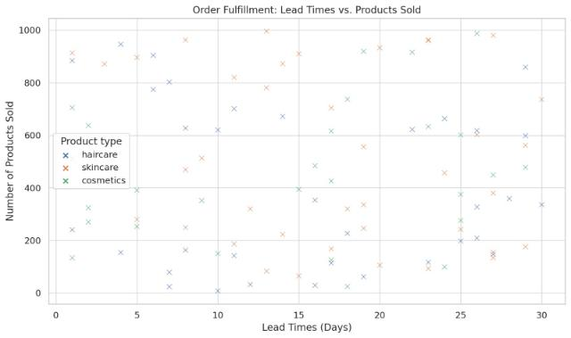
Order Fulfillment:
Lead times compared to the number of products sold.

Slide 6
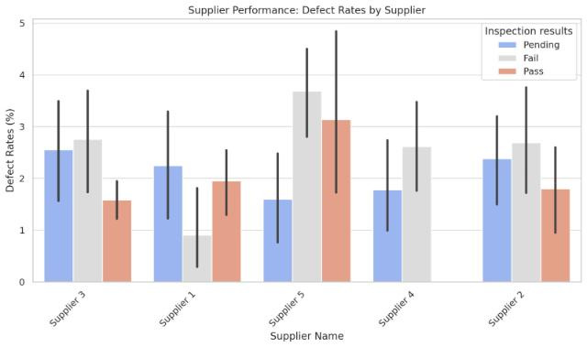
Supplier Performance: Defect Rates by Supplier
A bar chart showing defect rates for each supplier, categorized by inspection

Slide 7
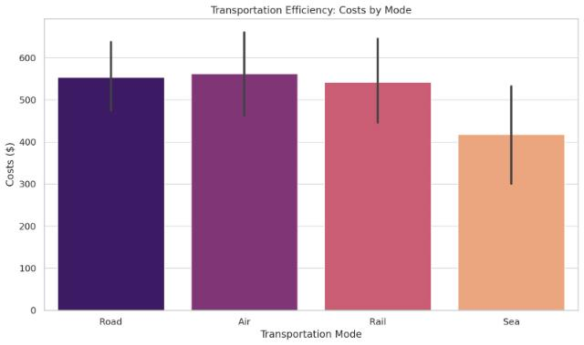
Transportation Efficiency
A bar chart showing the costs associated with different transportation modes.

Slide 8
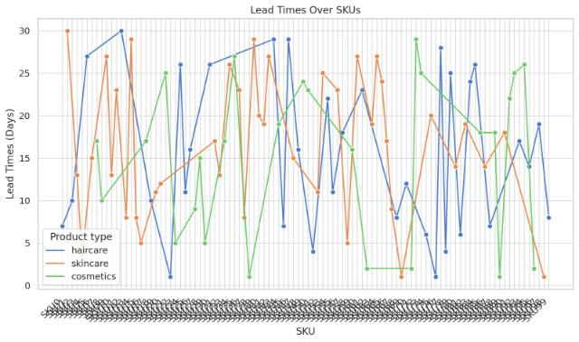
Line Graphs: Lead Times and Manufacturing Lead Times Over SKUs
Lead Times Over SKUs:
This graph shows how lead times vary across different SKUs, with data grouped by product type.

Slide 9
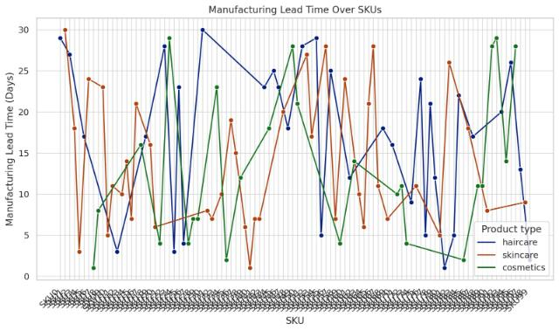
Line Graphs: Lead Times and Manufacturing Lead Times Over SKUs
Manufacturing Lead Time Over SKUs:
This graph visualizes the variation in manufacturing lead times for different SKUs, also grouped by product type.

Slide 10
Conclusion:
Data analysis is vital for optimizing supply chain operations and enhancing decision-making. It provides visibility across the supply chain, improving demand forecasting, inventory management, and supplier relationships. By identifying inefficiencies and potential risks, data analysis helps reduce costs and streamline operations. Additionally, it supports informed decision-making and enhances customer satisfaction by aligning supply chain strategies with customer needs. In essence, effective data analysis leads to a more efficient, resilient, and competitive supply chain.

Slide 11
Thank You:
Presented by Akshay M

